Slide 1
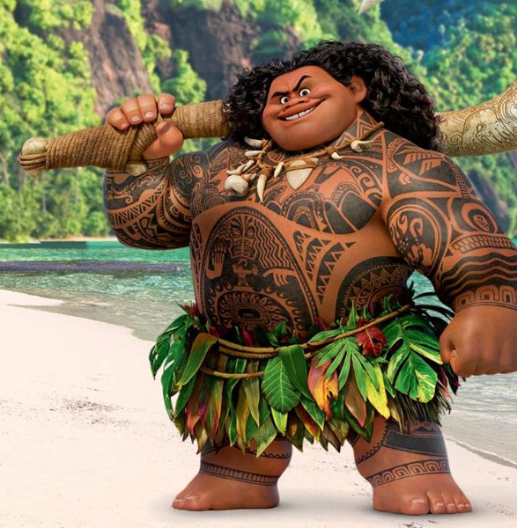
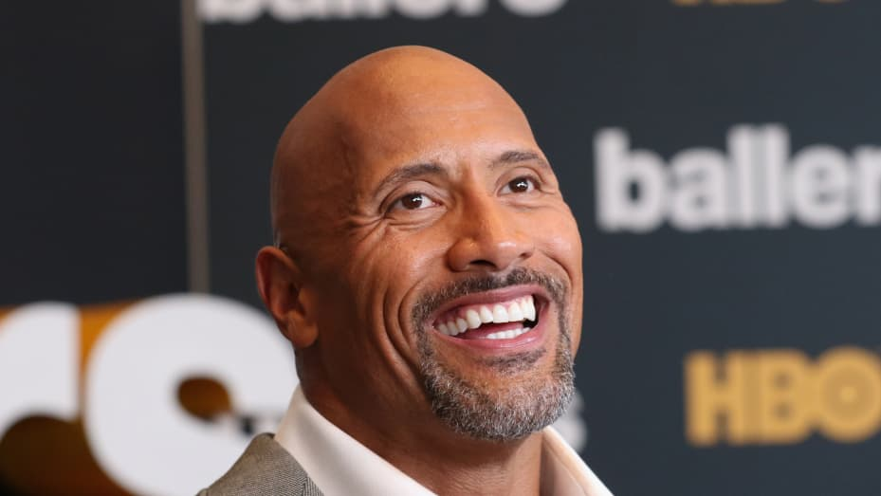
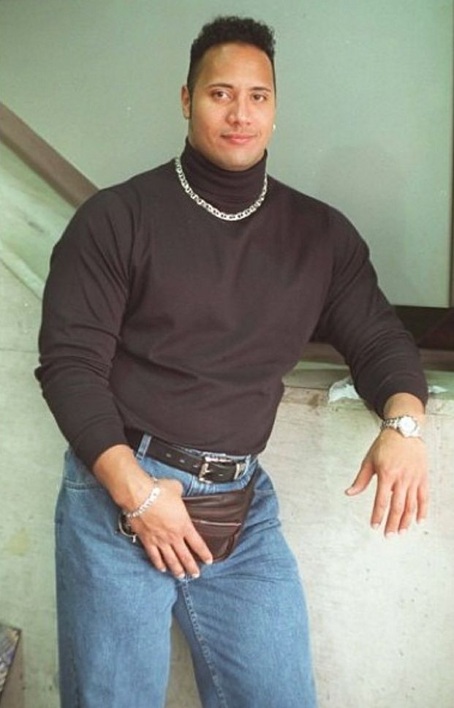
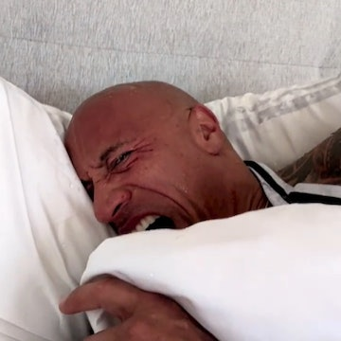
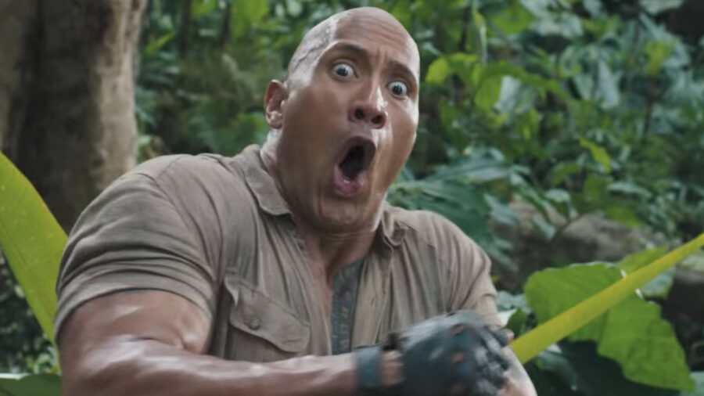
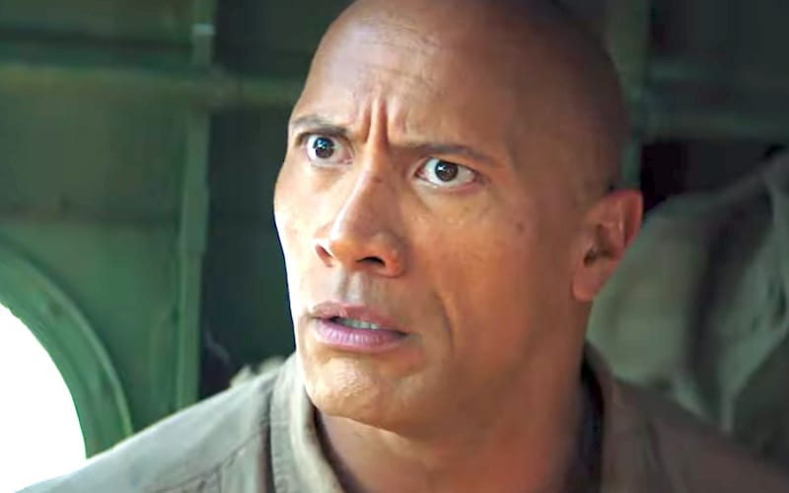
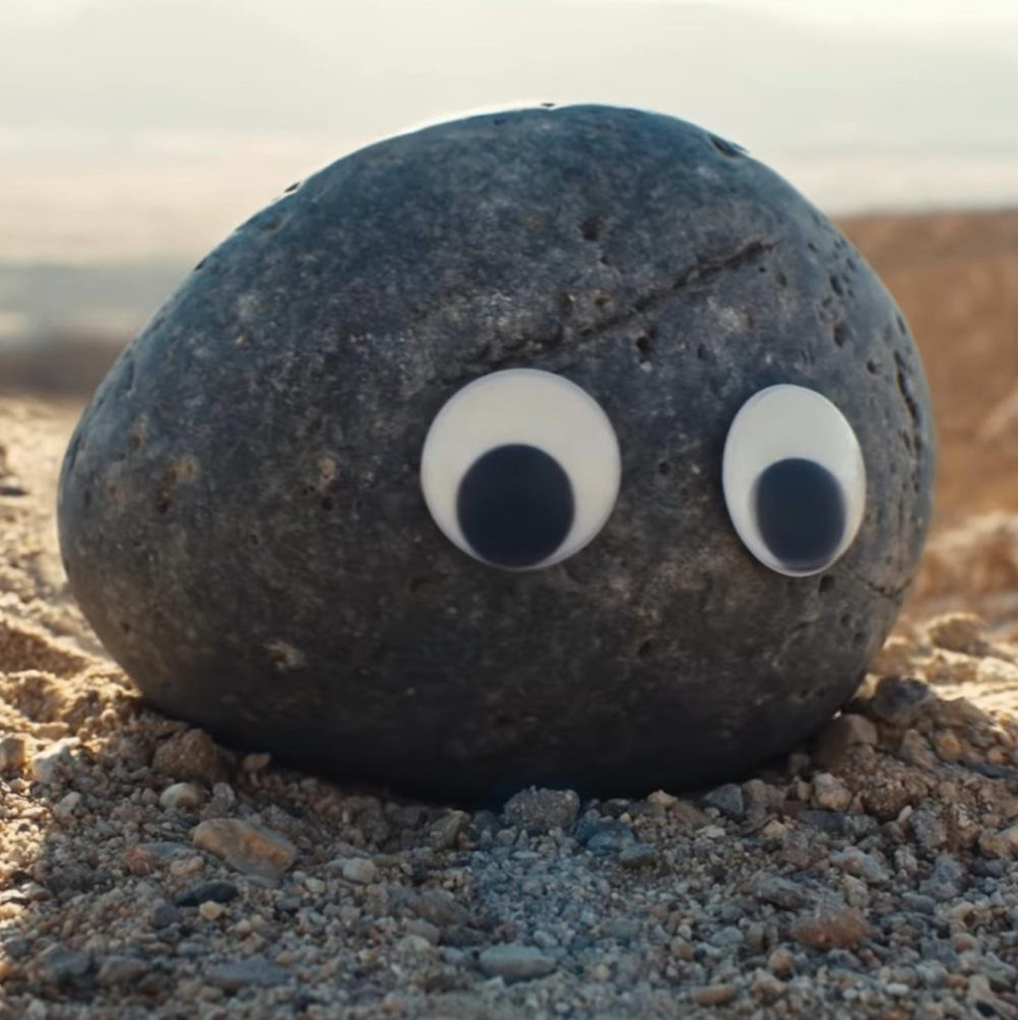
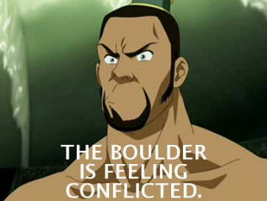
Which ‘The Rock’ are you today?
Go to
pollev.com/bolton
and follow the link
Keep the page open!

Slide 2
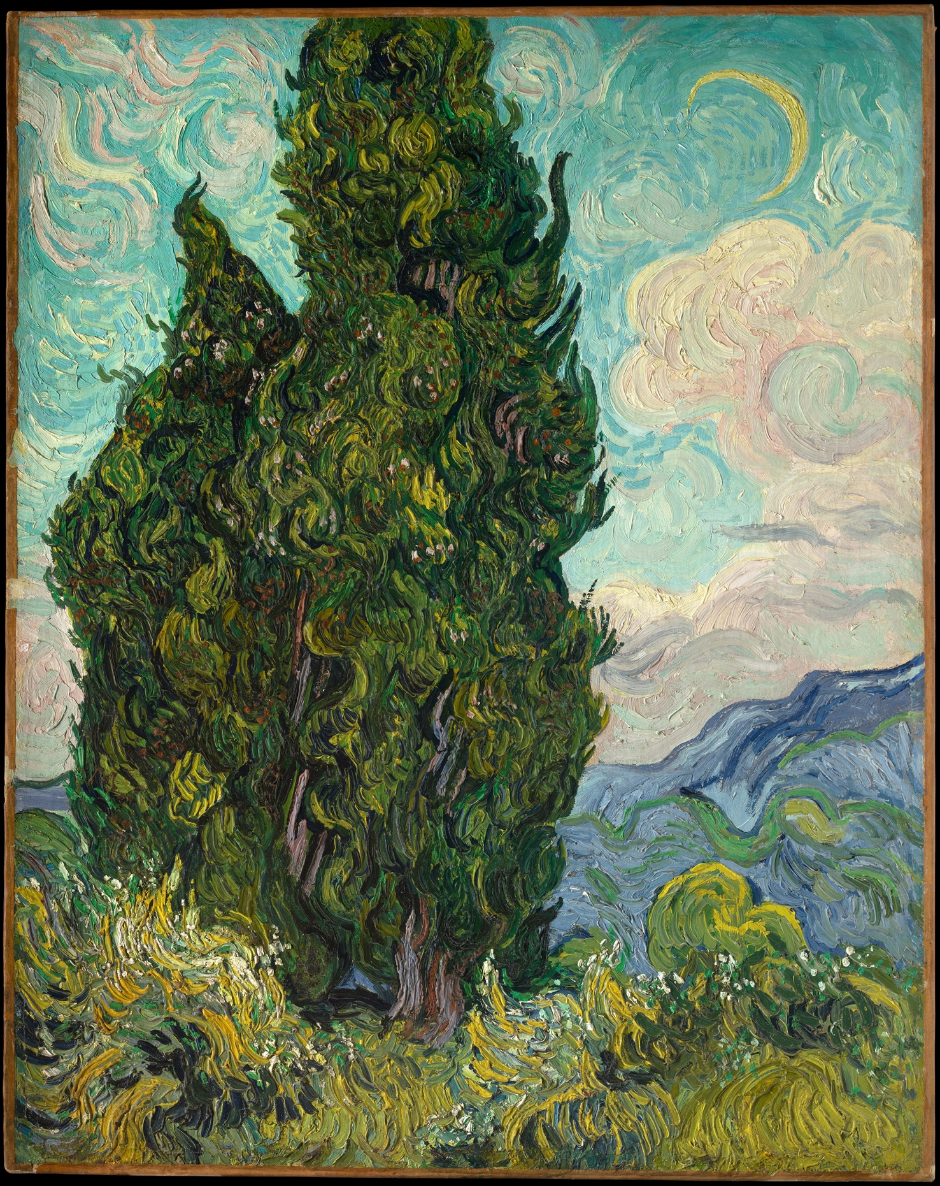

Quiz 4
available now
due 11:59 p.m. Friday, June 2
handouts 15 & 16
Quiz 4 | June 2 @ 11:59 PM
Vincent van Gogh

Slide 3
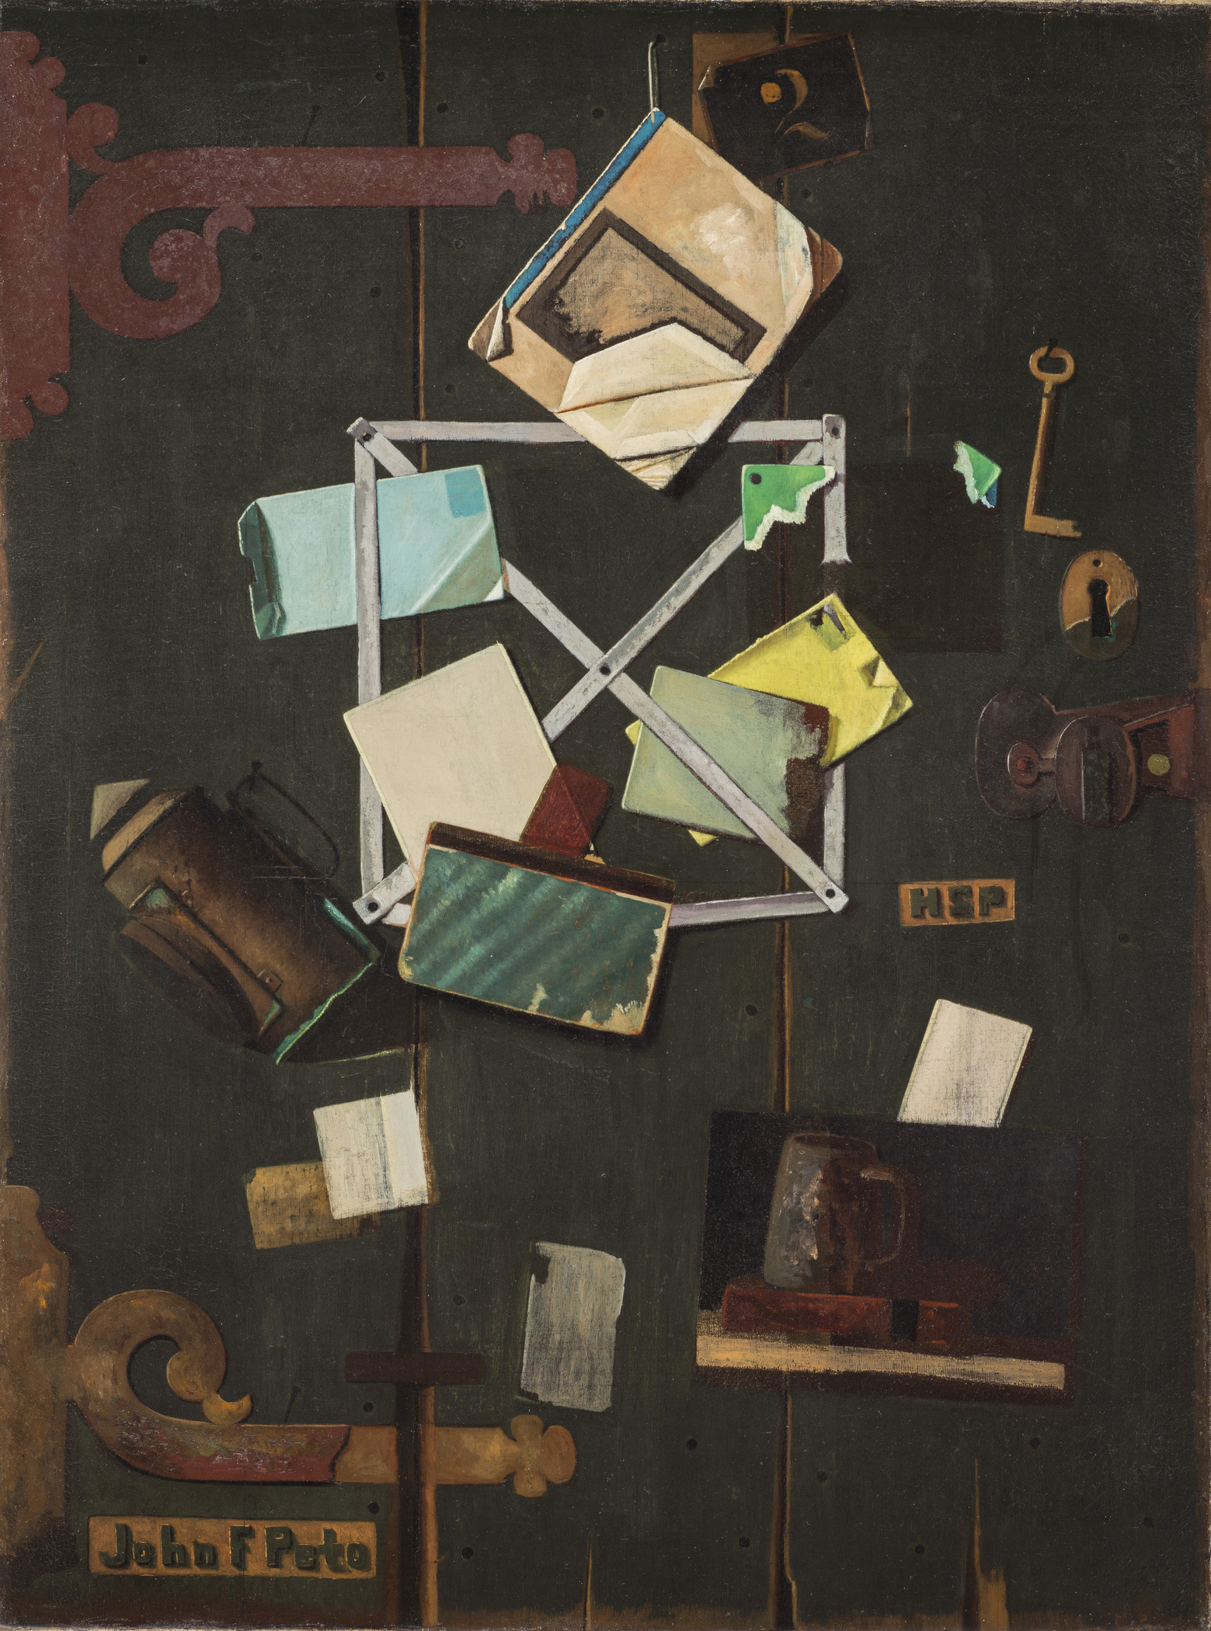
Assignment 4 You can do the whole assignment after today
due 7:00 p.m., Thursday, June 1
A4 | June 1 @ 7 PM
John Fredrick Peto

Slide 4
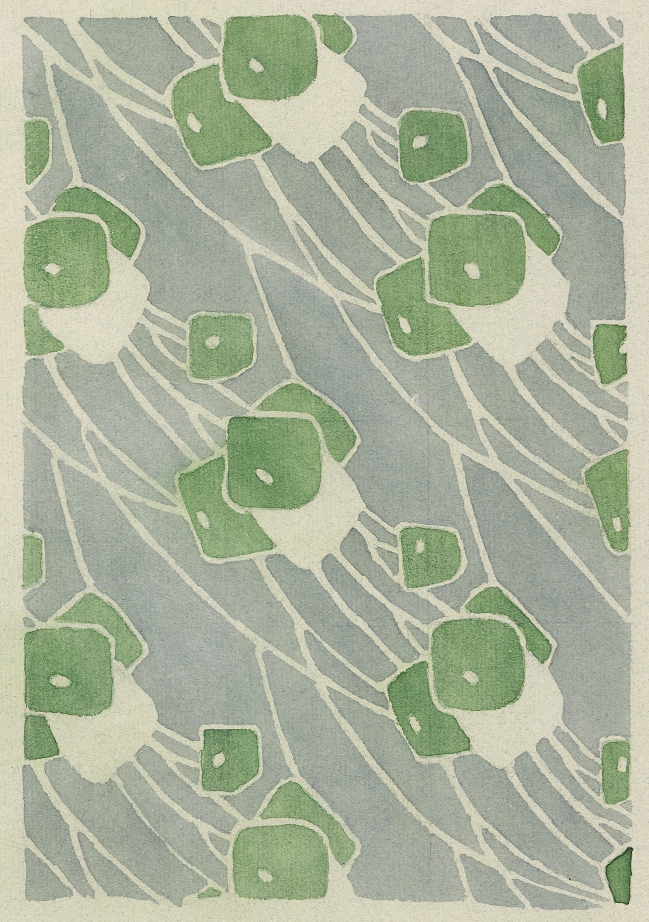

Exam
June 16
2 hours + 30 mins
Open book
Exam mode A
Exam | June 16 @ 1:30 PM
Hannah Borger Overbeck

Slide 5
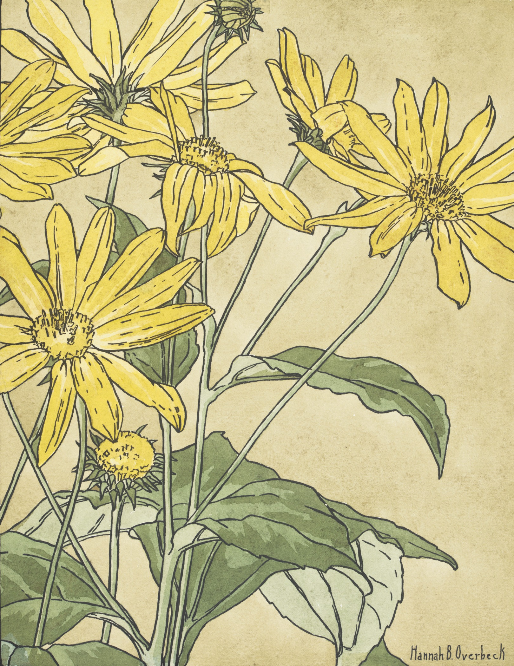
Exam
Question types:
TRUE/FALSE,
multiple choice,
tick all that apply,
dropdowns,
fill in the blank (numeric & text),
short answer (< paragraph), and
medium long written answers (up to a couple paragraphs).
Exam | June 16 @ 1:30 PM
Hannah Borger Overbeck

Slide 6
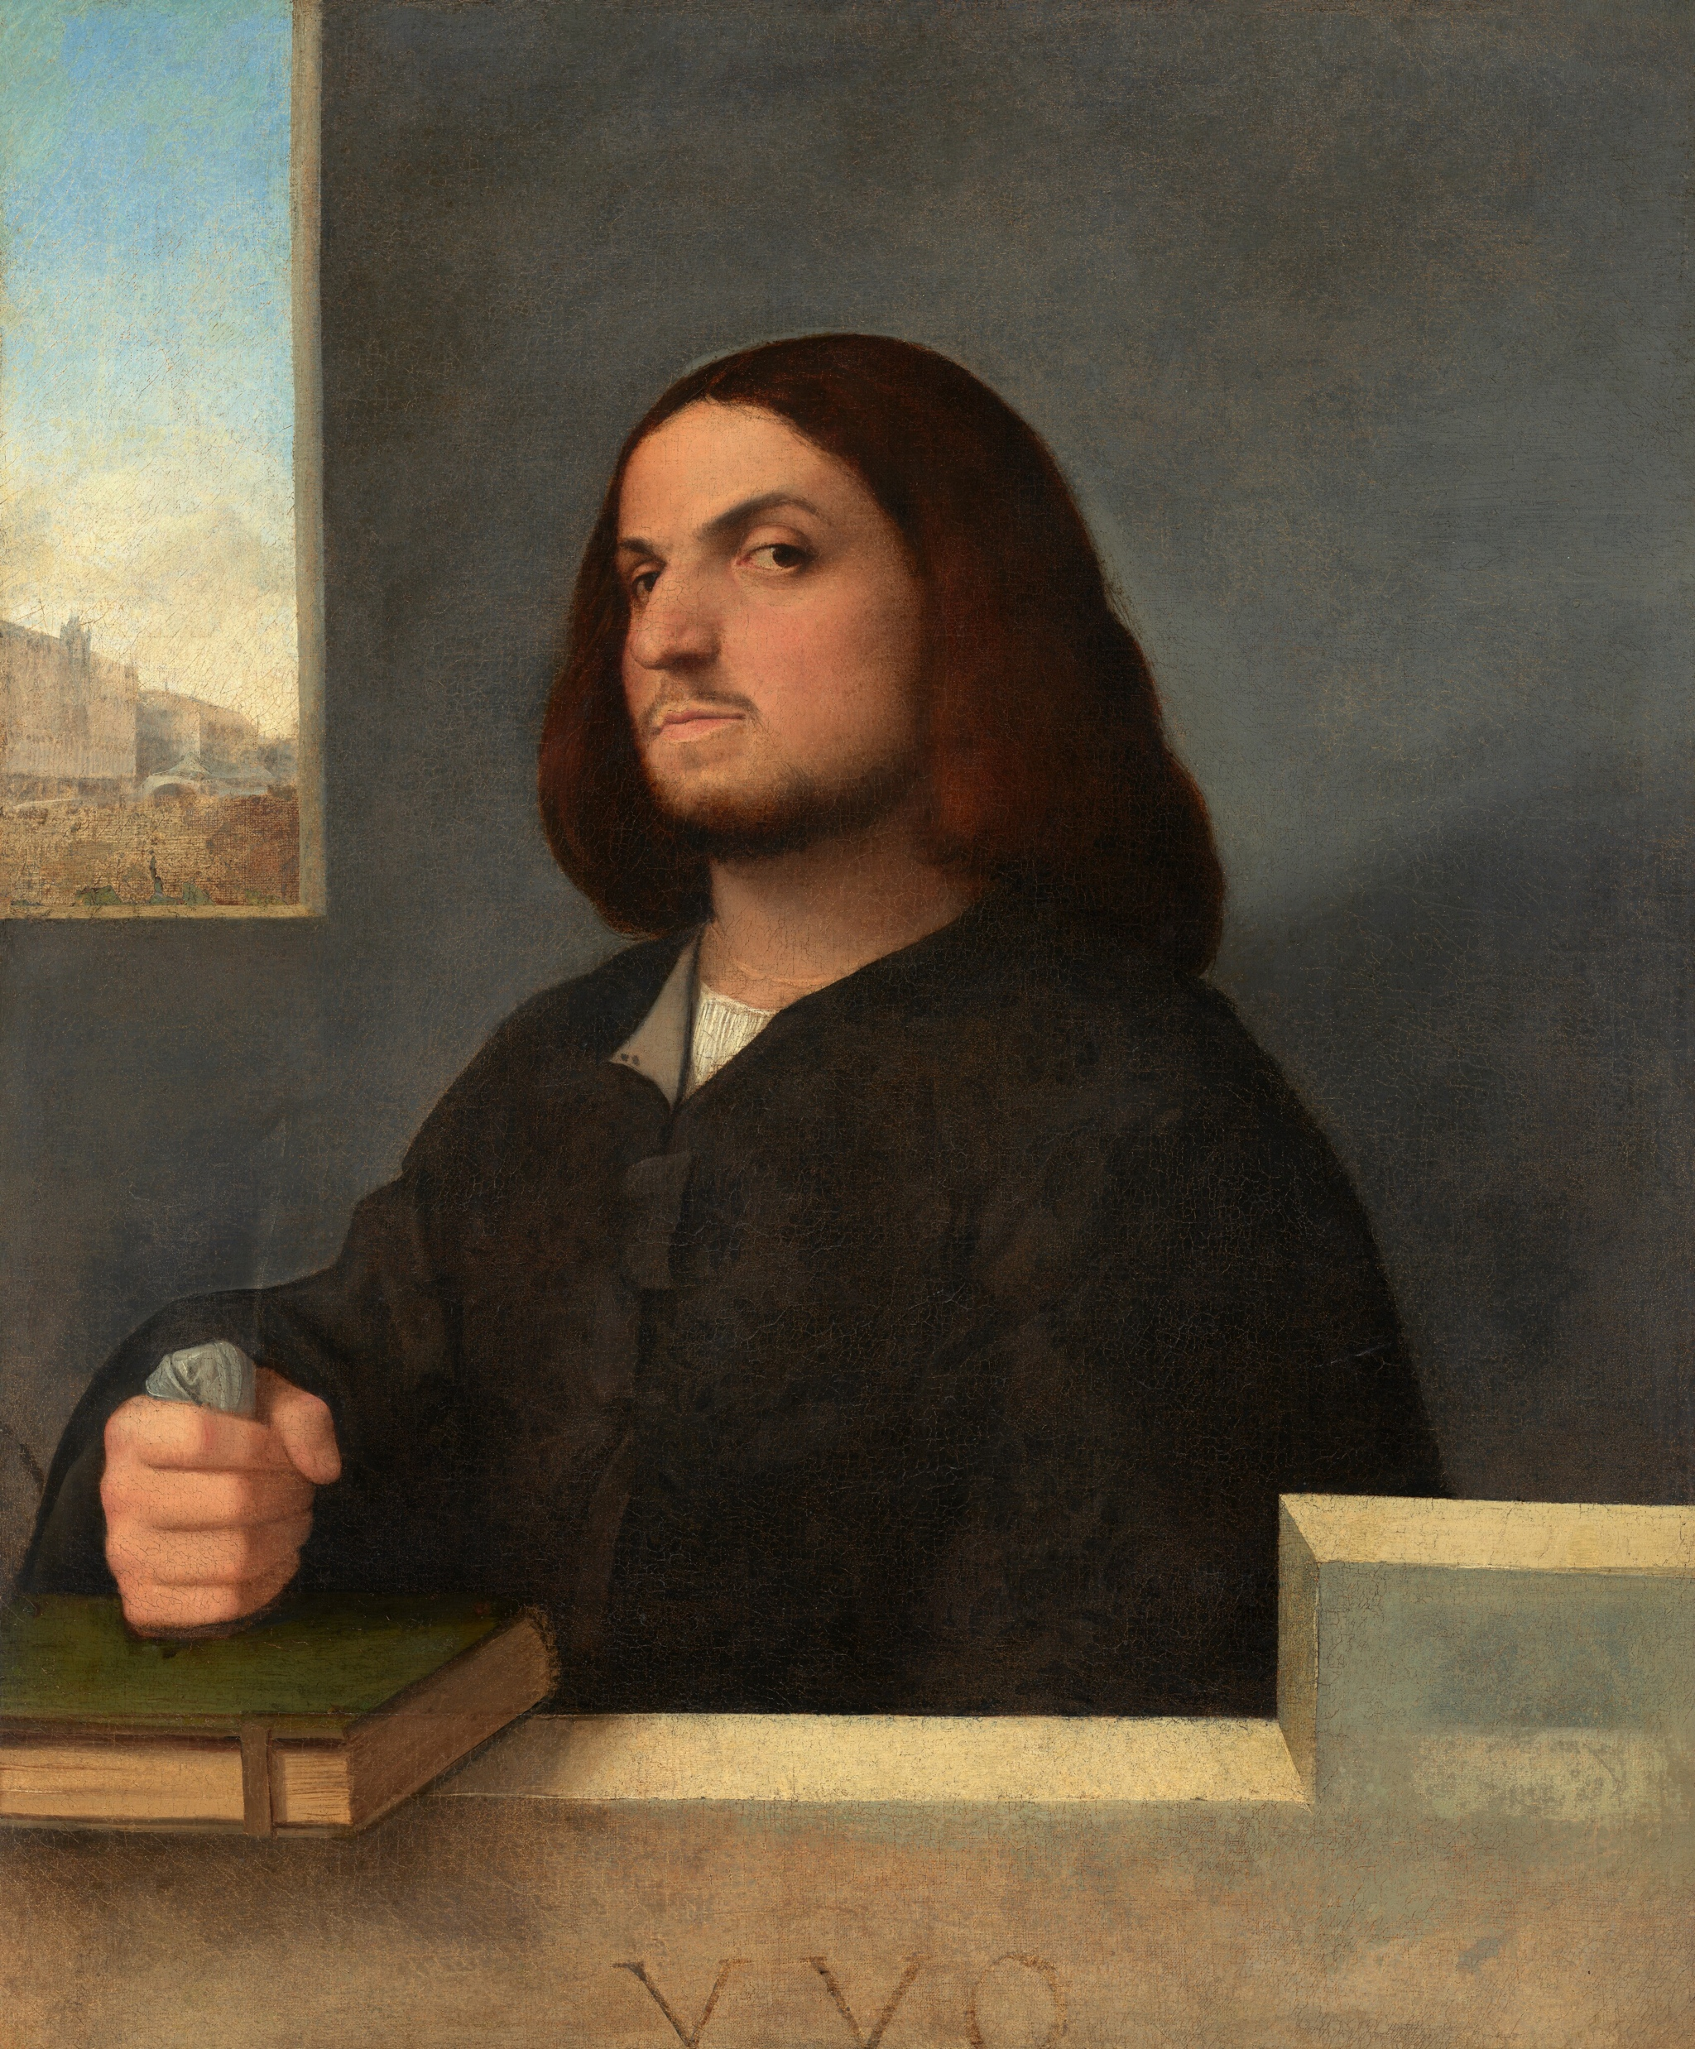
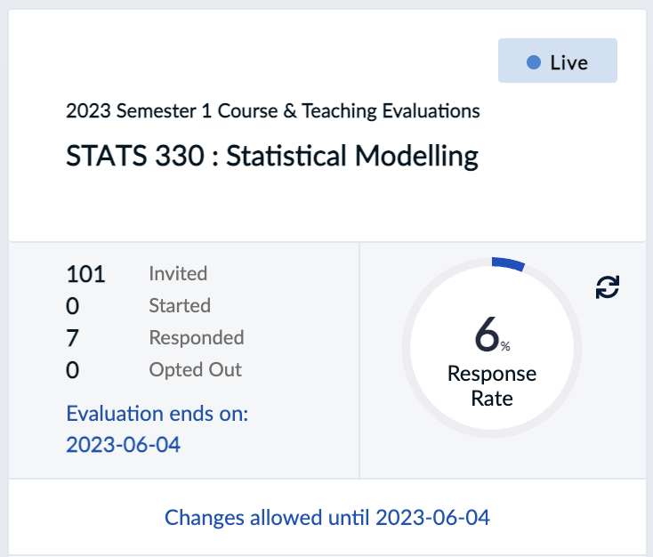
Please complete the SET report for STATS 330
(or else this Portrait of a Venetian Gentleman will give you ✨bombastic side-eye✨)
SET report | June 4
Cariani (painter) Venetian, 1485/1490 - 1547 or after

Slide 7
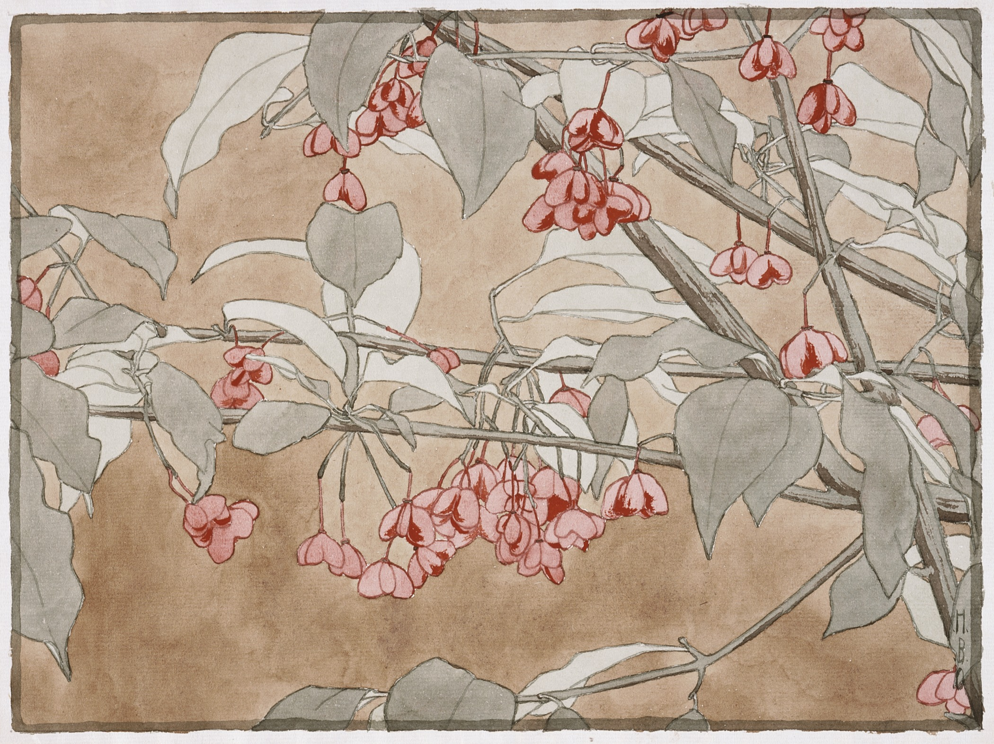

Drop-in assignment clinic
TOMORROW
11 AM to 12:30 PM
Stats Assistance Hub
Drop-in | May 31 @ 11 AM
Hannah Borger Overbeck

Slide 8
Which ‘The Rock’ are you today?
Go to
pollev.com/bolton
and follow the link
Keep the page open!

Slide 9
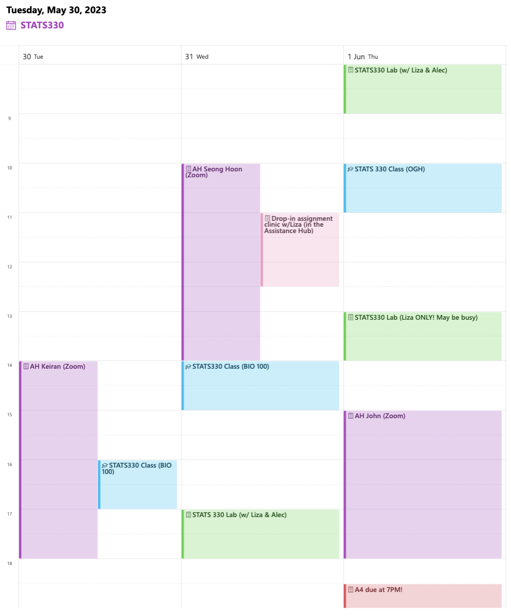
Week 12 help calendar
You can get this PDF at the top of the Canvas home page

Slide 10

Piazza will be inactive during the test, but you will be able to view past questions.

Slide 11
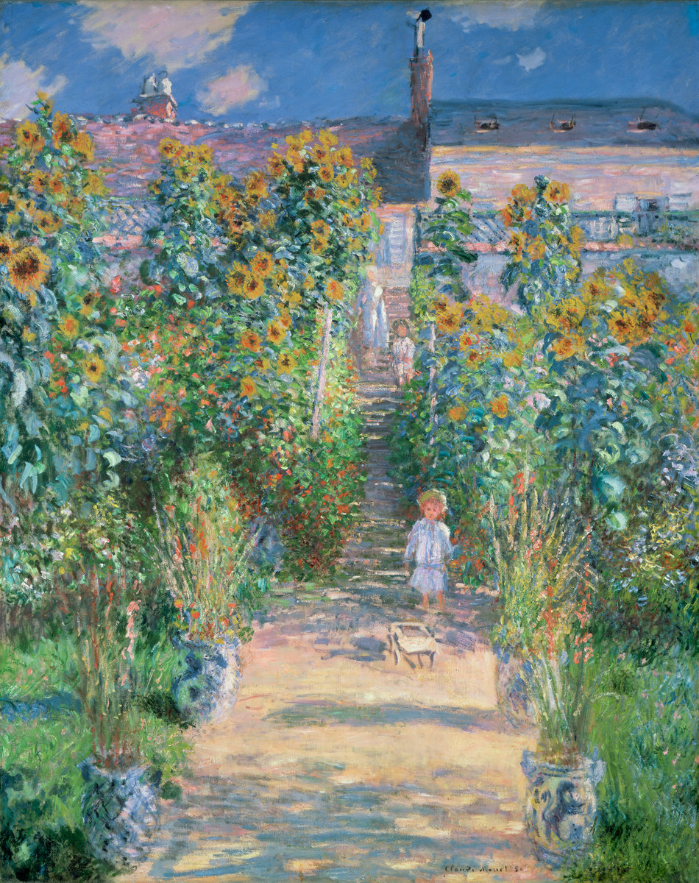
Labs
Wed: 5–6, 302-190
Thu: 8–9, 302-180
Thu: 1–2, 302-180
Come to any time that works for you!
Labs | Wednesdays and Thursdays
Claude Monet

Slide 12
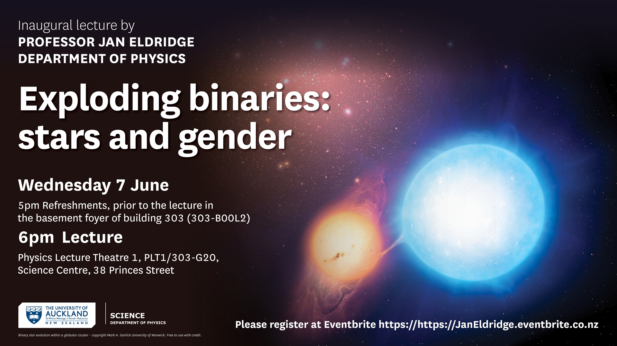

Slide 13
Which ‘The Rock’ are you today?
Go to
pollev.com/bolton
and follow the link
Keep the page open!

Slide 14
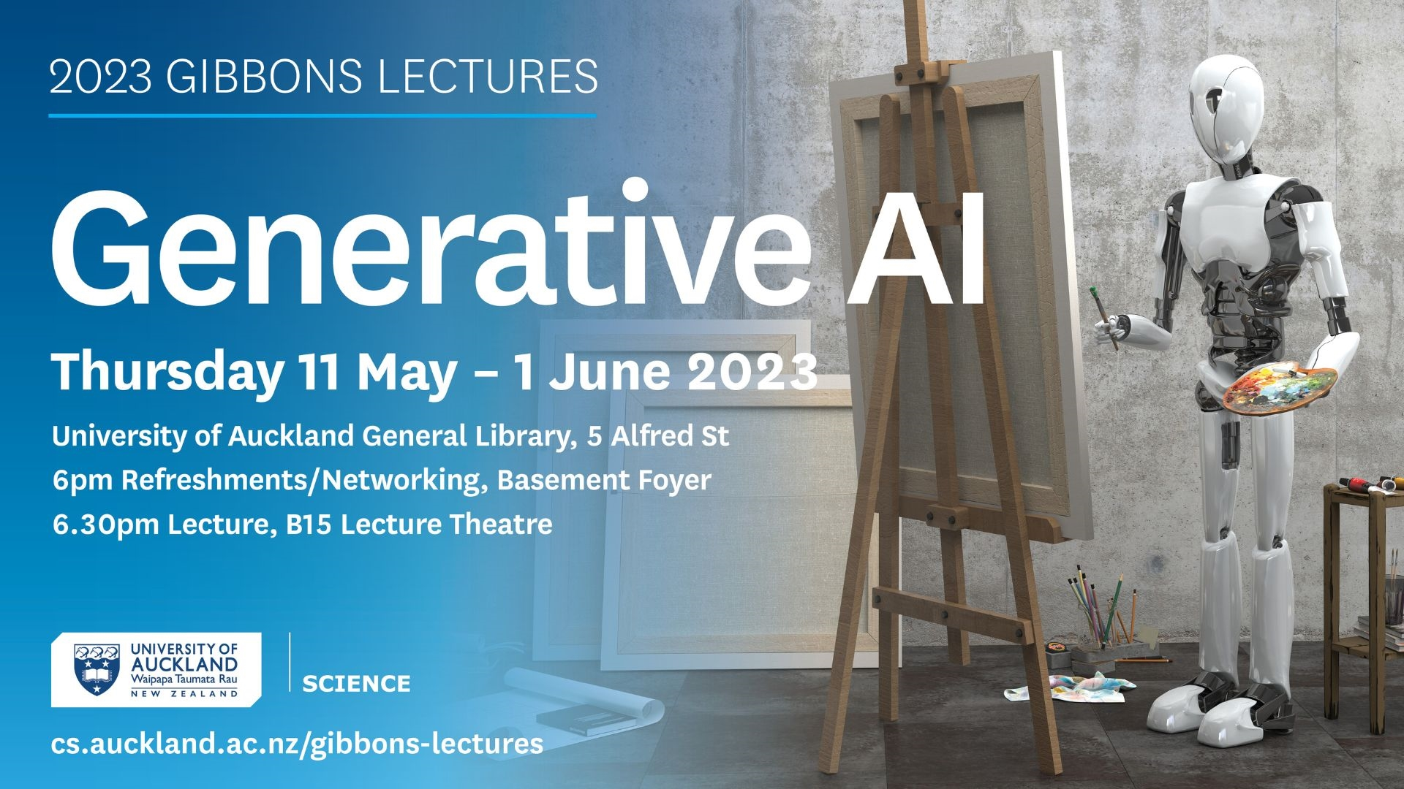

Slide 15
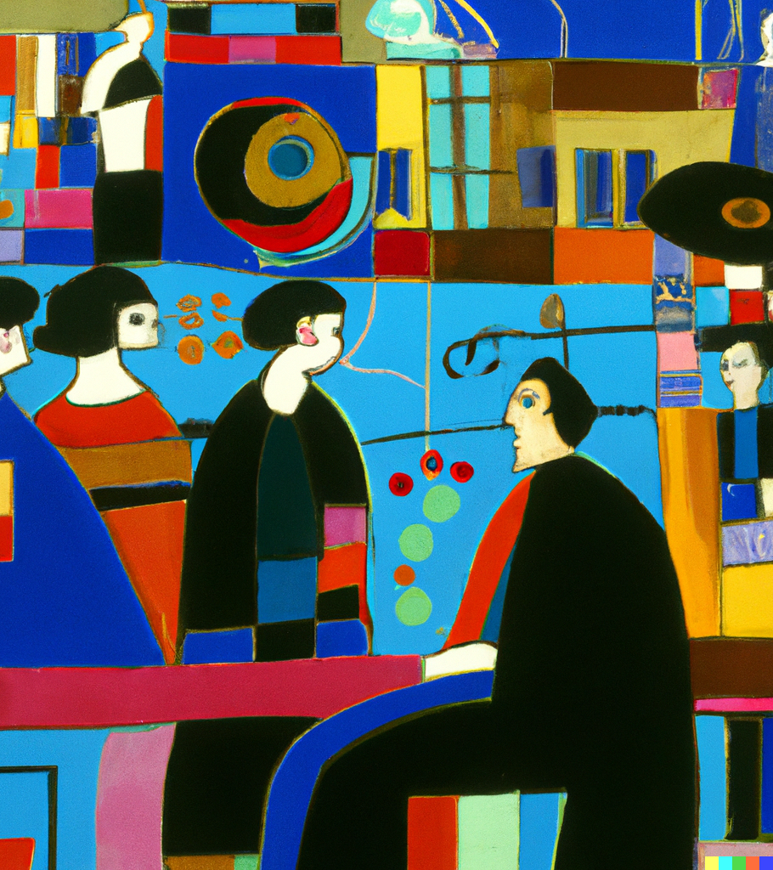
2023 Gibbons Lectures
AI and the New Creative Revolution
AI Colonisation and Mātauranga Sovereignty
How does generative AI work and what is its future?
ChatGPT and the Road to Artificial General Intelligence?
Register on Eventbrite (free)
Gibbons Lecture Series | May 11, 18, 25 and June 1
Generated with DALLE-2

Slide 16


Slide 17
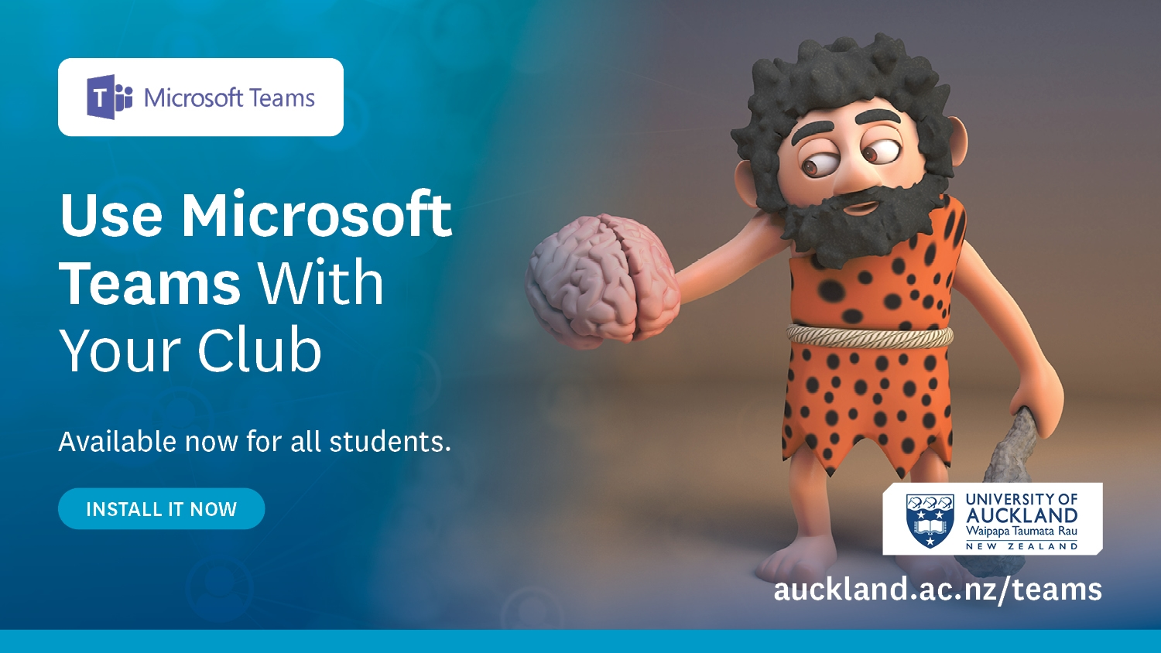

Slide 18


Slide 19


Slide 20


Slide 21


Slide 22


Slide 23
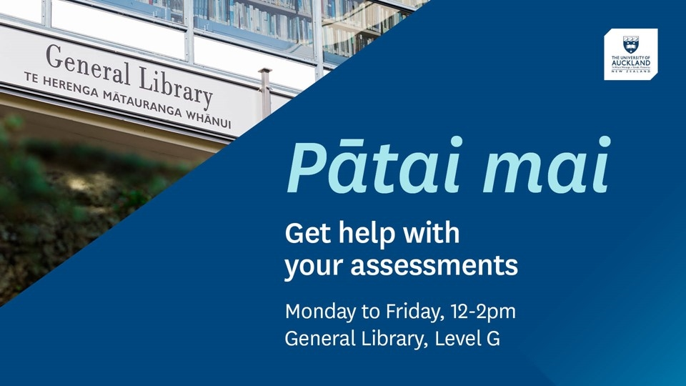

Slide 24


Slide 25
Which ‘The Rock’ are you today?
Go to
pollev.com/bolton
and follow the link
Keep the page open!

Slide 26


Slide 27


Slide 28
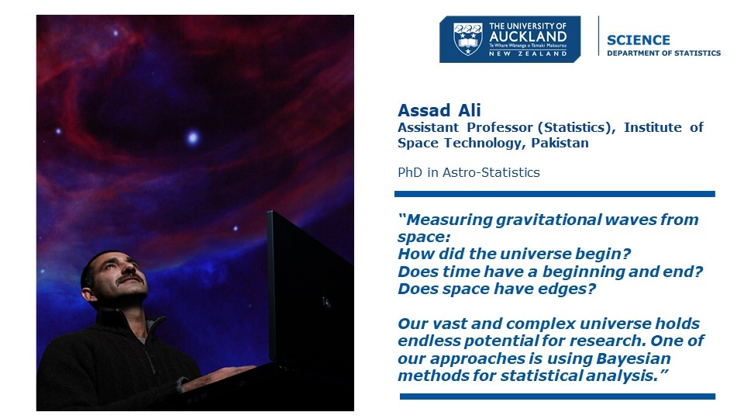

Slide 29
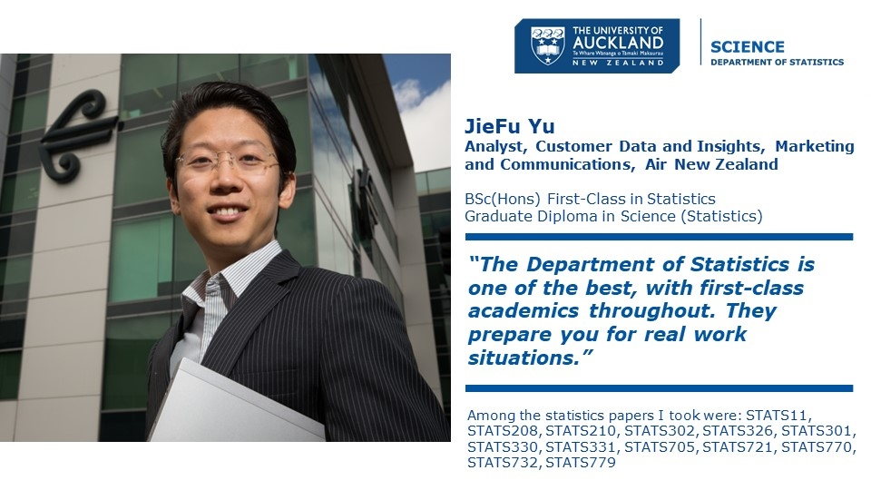

Slide 30
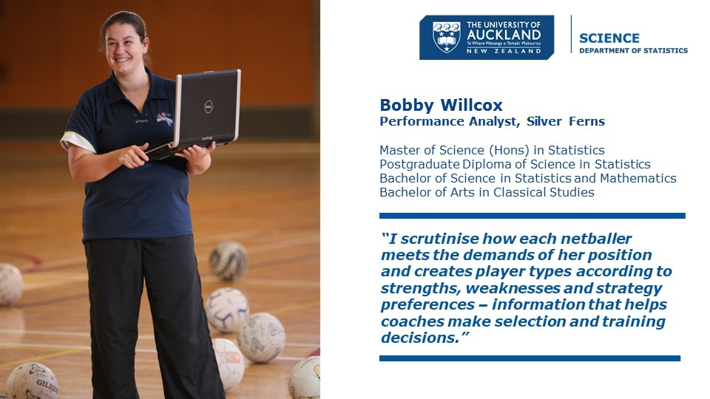

Slide 31
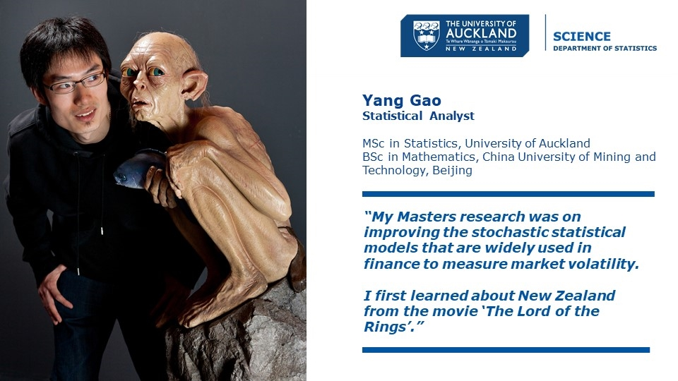

Slide 32
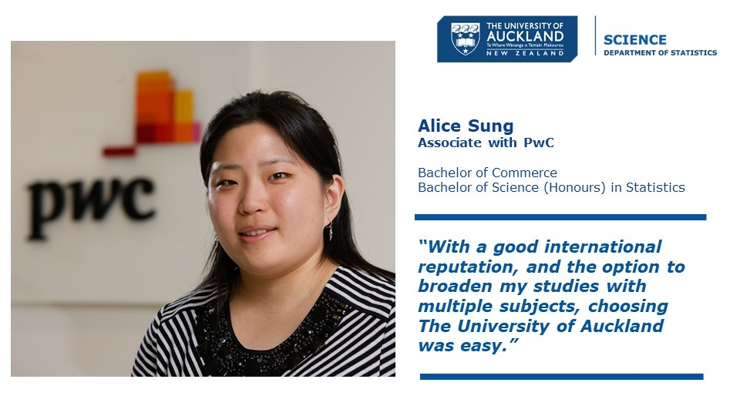

Slide 33
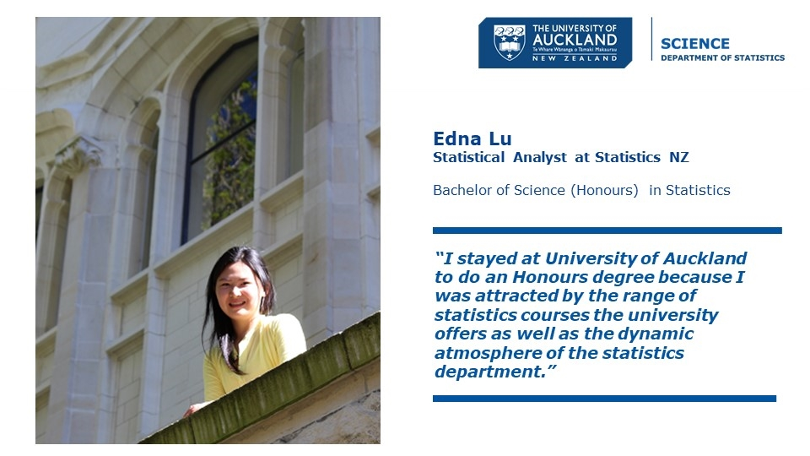

Slide 34
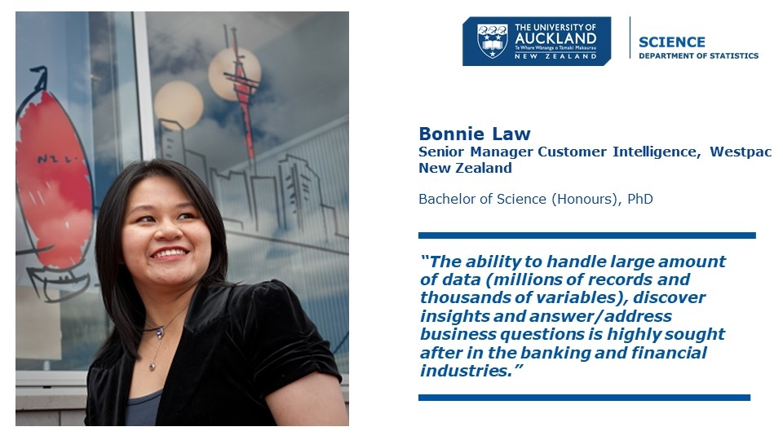

Slide 35


Slide 36


Slide 37


Slide 38


Slide 39


Slide 40


Slide 41
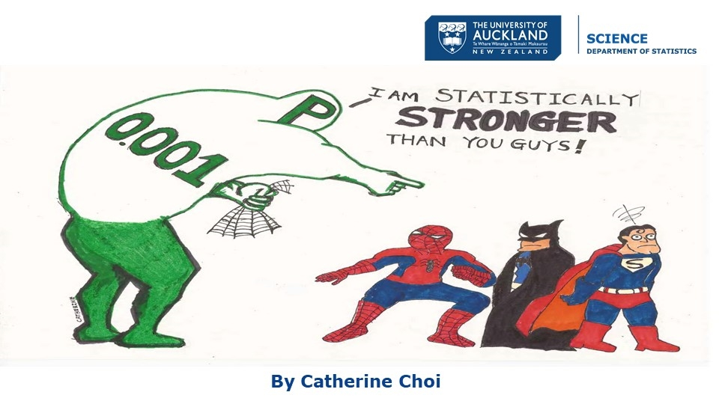

Slide 42
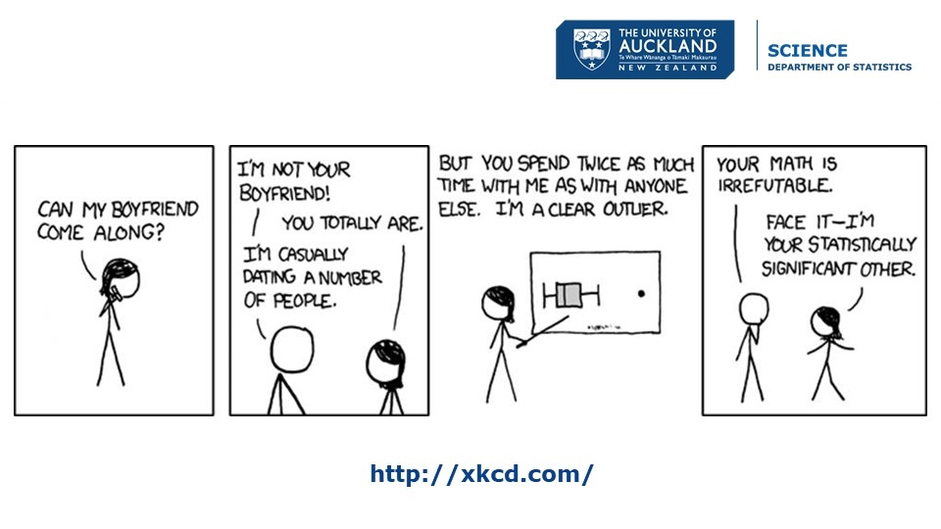

Slide 43
